Slide 1
Sales Data_Story
File created on: 5/25/2023 12:45:46 PM

Slide 2
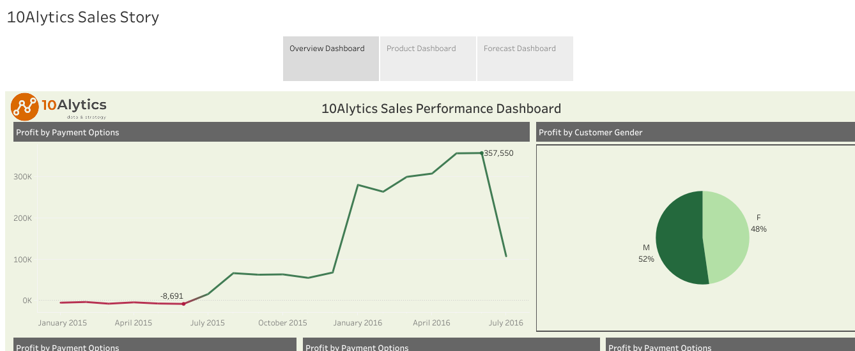

Slide 3
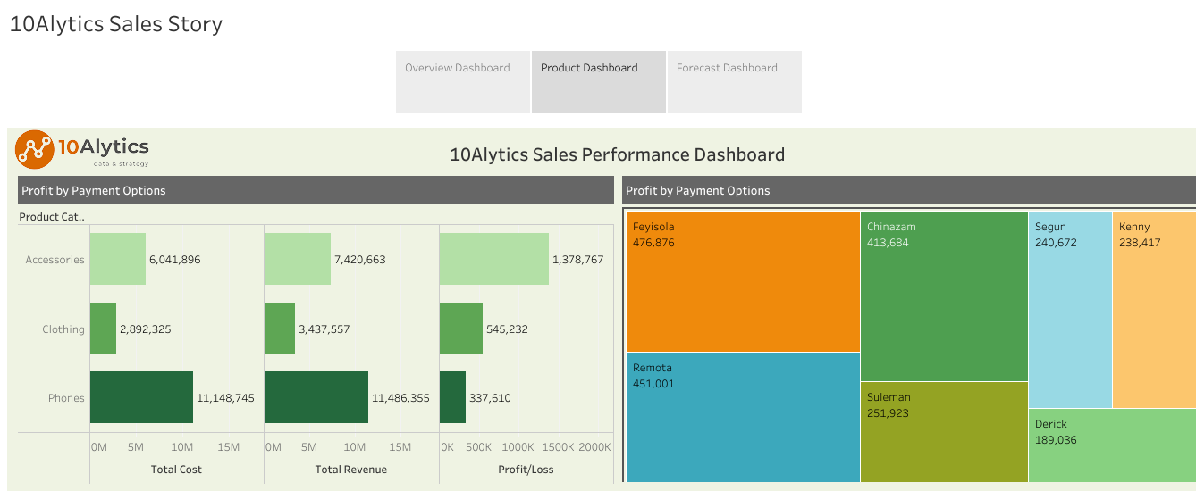

Slide 4
